Slide 1
JaCoCo by EclEmma
Presented by the Code Coverage Team

Slide 2
What is code coverage?
Metrics used to measure how much of the code is actually being tested

Slide 3
Code Coverage
Black box
  Are all possible scenarios being tested?
  Is every specification being tested?
White box
  What internal structures and logic is being tested?
    Test paths within a unit
    Test paths between units
    Test paths between subsystems

Slide 4
Black-Box Testing
Equivalence Class Partitioning: Partition input to cover all possible inputs (WECT/SECT)
Boundary-Value Analysis: Min, min+, nom, max-, max
Category-Partition: Divide each function into Categories and Parameters
Decision tables: Decide on conditions and responses to each
Cause-Effect Graphs: Used to help derive all possible combinations for your decision table
Logic Functions: n boolean variables mapped to 1 boolean output variable
Notes:
Product term or conjunctive clause: String of clauses related by the and operator
Sum-of-products or disjunctive normal form (DNF): Product terms related by the or operator
Implicant: Each term of a sum-of-products expression–sufficient condition to fulfill for True output of that expression

Slide 5
White-Box Testing: Control Flow vs Data Flow
Statement: All statements of code are executed
Edge: All edges of the CFG are executed (T/F of each condition)
Condition: Better form of Edge: All conditions covered
Path coverage: Determine critical paths, not all are feasible/possible
Definitions-Usages of data: possible set of values at various points
Coupling-based Coverage Criteria
  Integration testing
    Confidence in interfaces
  Definitions/Uses across interfaces
    Does the called function use the variable correctly?

Slide 6
Intro to JaCoCo

Slide 7
Intro to JaCoCo
JaCoCo: stands for “Java Code Coverage”
It is used to analyze and measure code covered by testing
In other words, JaCoCo can describe the degree to which the source code of a program is executed when a particular test suite runs.
If JaCoCo outputs a high code coverage percentage, this means that the code has more of its source code executed during testing and has less chances of containing undetected software bugs.

Slide 8
Why was it created?
Several open source coverage technologies are offered but few were really designed for integration
Other open source coverage technologies such as EMMA and Cobertura were widely used but are not actively maintained and do not support the current Java versions
Thus, JaCoCo was created to provide a new standard technology for code coverage analysis in Java
The mission was to provide a lightweight, flexible, and a well documented library for integration with various build and development tools
Notes:
Treats if and switch statements as branches,

Slide 9
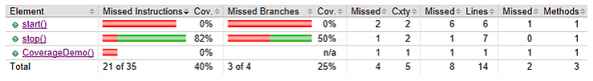
Perks
Conveniently free and created by the EclEmma team
Simple to use and integrates well with existing build scripts and tools
Has minimal runtime overhead even when working with large scale projects
Minimal dependencies on external libraries and system resources, giving an all around lightweight coverage tool
Displays easy to understand/read table of code coverage when used in conjunction with the EclEmma plugin (shown below)
Notes:
Treats if and switch statements as branches,

Slide 10
Features

Slide 11
Coverage Counters
Java byte code instructions
  Smallest unit
  Provides information about the amount of code that has been executed or missed
Branches
  Counts the total number of all if and switch statements in a method
Cyclomatic Complexity
  Serves as an indication for the number of unit test cases to fully cover the software
Lines
  Considered executed when at least one instruction assigned to the line has been executed
Methods
  Non-abstract method considered executed when at least one instruction has been executed
Classes
  Considered executed when at least one of its methods has been executed.

Slide 12
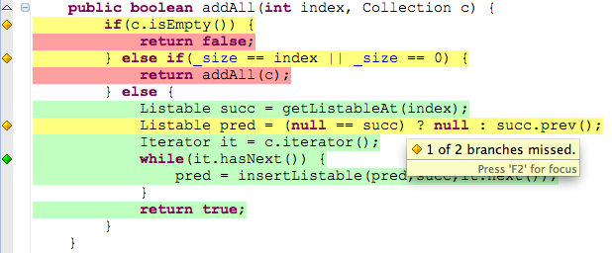
Coverage Reports
HTML - visual report for end users
XML - designed for further processing by other external tools
CSV - basic report type suitable for creating simple graphs
Highlights the lines of instructions that have not been called and/or have low code coverage

Slide 13
Other Features
Remote protocol and JMX control to request execution data dumps from the coverage agent at any point in time
  Via TCP/IP sockets
Ant tasks to collect and manage execution data and create structured coverage reports
Merge sessions
Command line interface
  dump, instrument, merge, report, classinfo, execinfo, version
Java Agent
  Instruments classes on-the-fly
  Simplifies code coverage analysis a lot as no pre-instrumentation and classpath tweaking is required

Slide 14
Black-Box Testing Criteria

Slide 15
Equivalence Class Partitioning
Equivalence classes: partition of input set
Avoid redundancy (disjoint classes)
Test cases: one element of each equivalence class

Slide 16
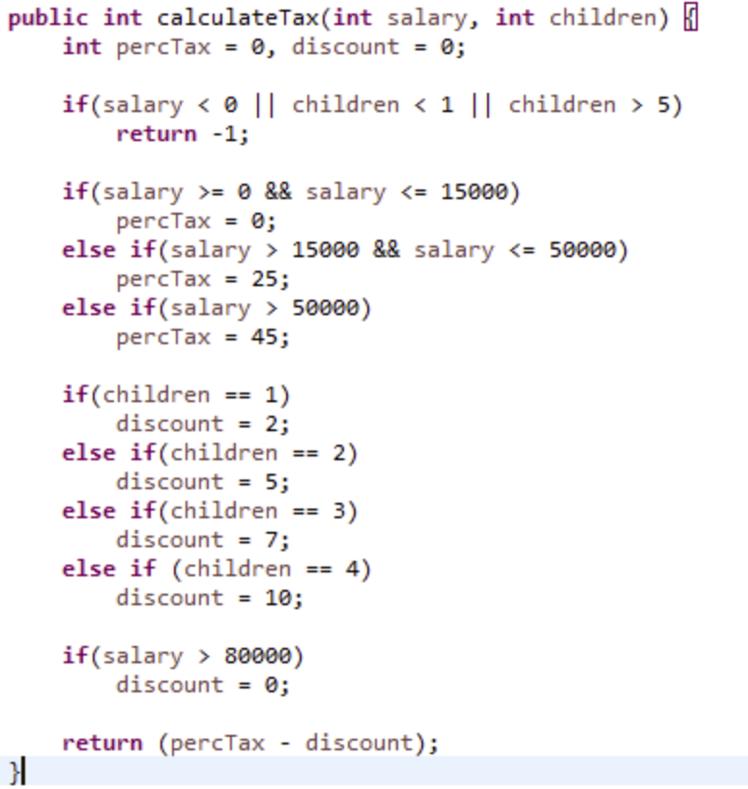
Equivalence Class Partitioning

Slide 17
Equivalence Class Partitioning
ID: | Salary | Children | Output
WECT1 | S1: Sal = 12k | C1: c = 1 | -2
WECT2 | S2: Sal = 16k | C2: c = 2 | 20
WECT3 | S3: Sal = 70k | C3: c = 3 | 38
WECT4 | S4: Sal = 90k | C4: c = 4 | 45
WECT5 | S5: Sal < 1 | C5: c = 0 | -1
S1 = { salary: 1 <= salary <= 15,000 }
S2 = { salary: 15,001 <= salary <= 50,000 }
S3 = { salary: 50,001 <= salary <= 80,000 }
S4 = { salary: > 80,000 }
S5 = { salary: < 0 }
C1 = { children = 1 }
C2 = { children = 2 }
C3 = { children = 3 }
C4 = { children = 4 }
C5 = { children < 1 || children > 4 }

Slide 18
Equivalence Class Partitioning
ID: | Salary | Children | Output
SECT1 | S1: Sal = 12k | C1: c = 1 | -2
SECT2 | S1: Sal = 13k | C2: c = 2 | -5
SECT3 | S1: Sal = 14k | C3: c = 3 | -7
SECT4 | S1: Sal = 14.5k | C4: c = 4 | -10
SECT5 | S1: Sal = 14.5k | C5: c = 0 | 0
SECT6 | S2: Sal = 16k | C1: c = 1 | 23
SECT7 | S2: Sal = 17k | C2: c = 2 | 20
SECT8 | S2: Sal = 47k | C3: c = 3 | 18
SECT9 | S2: Sal = 40k | C4: c = 4 | 15
SECT10 | S2: Sal = 40k | C5: c = 0 | -1
SECT11 | S3: Sal = 60k | C1: c = 1 | 43
SECT12 | S3: Sal = 70k | C2: c = 2 | 40
ID: | Salary | Children | Output
SECT13 | S3: Sal = 75k | C3: c = 3 | 38
SECT14 | S3: Sal = 76k | C4: c = 4 | 35
SECT15 | S3: Sal = 75k | C5: c = 0 | 45
SECT16 | S4: Sal = 81k | C1: c = 1 | 45
SECT17 | S4: Sal = 88k | C2: c = 2 | 45
SECT18 | S4: Sal = 100k | C3: c = 3 | 45
SECT19 | S4: Sal = 90k | C4: c = 4 | 45
SECT20 | S4: Sal = 90 | C5: c = 0 | 45
SECT21 | S5: Sal = -12 | C1: c = 1 | -1
SECT22 | S5: Sal = -1 | C1: c = 2 | -1
SECT23 | S5: Sal = -12 | C1: c = 3 | -1
SECT24 | S5: Sal = -12 | C1: c = 4 | -1
SECT25 | S5: Sal = -12 | C1: c = 0 | -1

Slide 19
Boundary Value Analysis
Use equivalence classes to pick boundary value test sets
Test set
{ <s1_{nom} ,c1_{min}>, <s1_{nom} ,c1_{min+}>, <s1_{nom} ,c1_{nom}>, <s1_{nom} ,c1_{max-}>, <s1_{nom} ,c1_{max}>, <s1_{min} ,c1_{nom}>, <s1_{min+} ,c1_{nom}>, <s1_{max-} ,c1_{nom}>, <s1_{max} ,c1_{nom}> }
= { <s1: 40k, c1: 0>, <s1: 40k, c1: 1>, <s1: 40k, c1: 2>, <s1: 40k, c1: 3>,<s1: 40k, c1: 4>, <s1: -1, c1: 2>,
<s1: 0 , c1: 2>, <s1: 80,000, c1: 2>, <s1: 80,001, c1: 2>, }

Slide 20
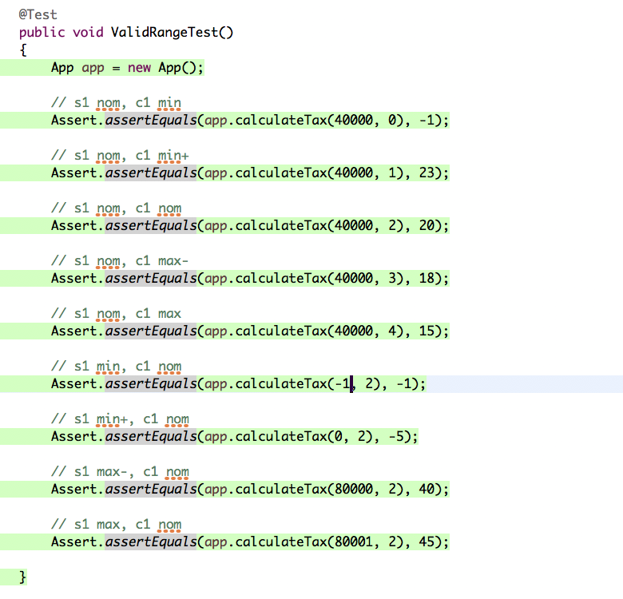
Boundary Value Analysis in Action

Slide 21
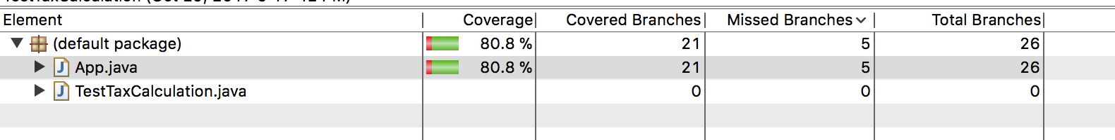
Boundary Value Analysis in Action

Slide 22
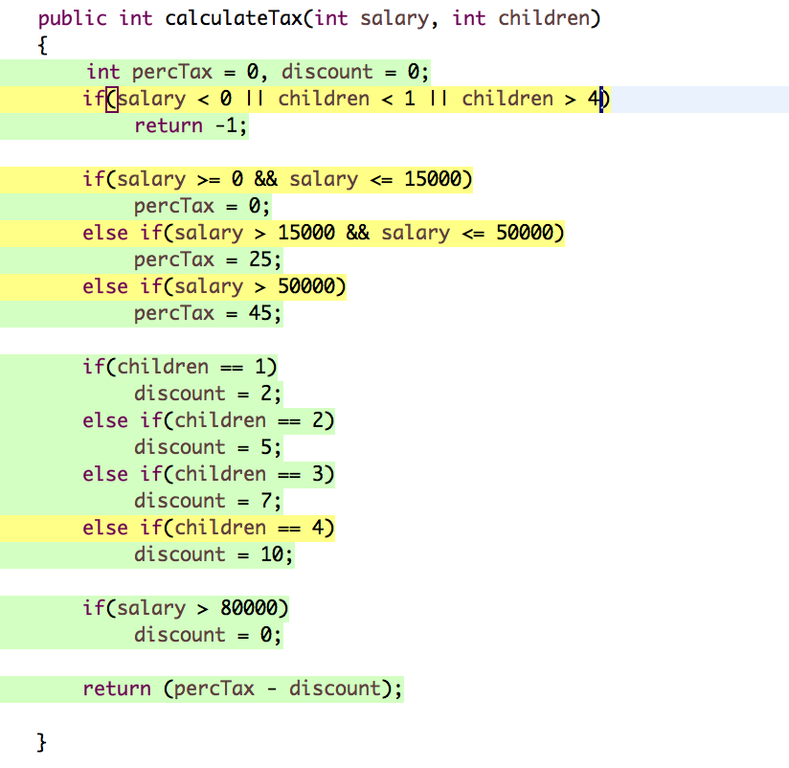
Boundary Value Analysis in Action

Slide 23
Category Partitioning

Slide 24
What is category partitioning?
Divide the system into independently testable features
Identify categories for the parameters (characteristics)
Come up with choices for each category
Identify constraints for each of the choices
Generate test frames and cases

Slide 25
Consider the following...
Tax calculation:
If salary <= 15,000: no tax
If salary <=50,000 : 25% tax
If salary > 50,000: 45% tax
Tax discount:
If 1 child: 2% discount
If 2 children: 5% discount
If 3 children: 7% discount
If 4 children: 10% discount
No discount if salary > 80,000

Slide 26
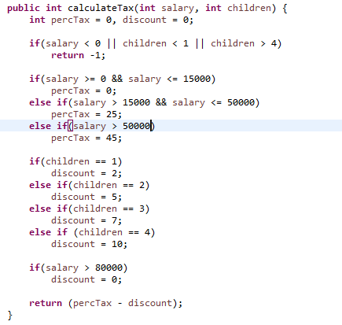
Source Code

Slide 27
Categories/Characteristics
Salary: {error, low, medium, high, rich}
Children {error, no kid, 1 kid, 2 kid, 3 kid, 4 kid}
Tax {error, 25, 45}
Tax discount {error, 0, 2, 5, 7, 10}

Slide 28
Choices
Salary | Children | Tax | Discount
-1 | -1 | -1 | -1
7,500 | 1 | 0 | 0
30,000 | 2 | 25 | 2
65,000 | 3 | 45 | 5
85,000 | 4 |  | 7
 | 5 |  | 10

Slide 29
Constraints
(s1) Salary: < 0 | [Error]
(s2) Salary: >=0 && <= 15,000 | [OK, property low]
(s3) Salary: > 15,000 && <= 50,000 | [OK, property medium]
(s4) Salary: > 50,000 && <= 80,000 | [OK, property high]
(s5) Salary: > 80,000 | [OK, property rich]
(c1) Child: < 1 | [Error, no child]
(c2) Child: = 1 | [OK, property 1 child]
(c3) Child = 2 | [OK, property 2 children]
(c4) Child = 3 | [OK, property 3 children]
(c5) Child = 4 | [OK,property 4 children]

Slide 30
(c6) Child: > 4 | [Error]
(t1) Tax < 0 | [Error]
(t2) Tax = 0 | [OK, if salary low]
(t3) Tax = 25 | [OK, if salary medium]
(t4) Tax = 45 | [OK, if salary high or rich]
(d1) Discount < 0 | [Error]
(d2) Discount = 0 | [OK, if no kids && (rich or low)]
(d3) Discount = 2 | [OK, if 1 kid && (medium or high)]
(d4) Discount = 5 | [OK, if 2 kids && (medium or high)]
(d5) Discount = 7 | [OK, if 3 kids && (medium or high)]
(d6) Discount = 10 | [OK, if 4 kids && (medium or high)]

Slide 31
Building test cases for all combinations
Test frames are generated by the cross product of all legal choices
  For example, if an [Error] state is encountered, we stop the expansion
Example: s1 does not expand as it generates [Error], but s2 does expand into: s2 c[2-5] t[2-4] d[2-6]

Slide 32
Alternative test building criteria
Each choice: One value from each choice for each category must be used at least in one test case
Base choice: A base choice is chosen for each category, and a first base test is formed by using the base choice for each category. Subsequent tests are chosen by holding all but one base choice constant

Slide 33
Test Frames
s1 | Salary = -1 [error]
s2,c1 | Salary = 7,500 & children = 0 [error]
s2, c2 | Salary = 7,500 & children = 1 [OK, t2, d3]
s2, c3 | Salary=7,500 & children = 2 [OK,t2,d4]
s2, c4 | Salary = 7,500 & children = 3 [OK,t2,d5]
s2, c5 | Salary = 7,500 & children = 4 [OK,t2,d6]

Slide 34
s3, c1 | Salary = 35,000 & children = 0 [error]
s3, c2 | Salary = 35,000 & children = 1 [OK, t3,d3]
s3,c3 | Salary = 35,000 & children = 2 [OK, t3,d4]
s3,c4 | Salary = 35,000 & children = 3 [OK, t3,d5]
s3,c5 | Salary = 35,000 & children = 4 [OK, t3,d6]
s4, c1 | Salary=65,000 & children = 0[error]
s4, c2 | Salary = 65,000 & children = 1 [OK, t4, d3]

Slide 35
s4, c3 | Salary = 65,000 & children = 2 [OK, t4, d4]
s4, c4 | Salary = 65,000 & children = 3 [OK, t4, d5]
s4, c5 | Salary = 65,000 & children = 4 [OK, t4, d6]
s5, c1 | Salary =85,000 & children =0 [error]
s5, c2 | Salary = 85,000 & children = 1 [OK, t4, d2]

Slide 36
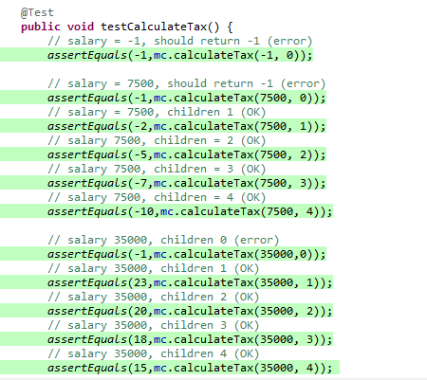
Source Code for Testing

Slide 37
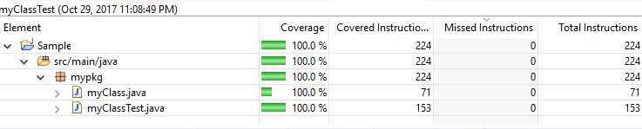
Results

Slide 38
Decision Table-Based Testing
A Decision Table is the method used to build a complete set of test cases without using the internal structure of the program in question.
In order to create test cases we use a table to contain the input and output values of a program.
A column in the entry portion of the table is known as a rule.
Values which are in the condition entry columns are known as inputs.
Values inside the action entry portions are known as outputs.

Slide 39
Conditions:
Actions:
C1: salary < 0
C2: 0 <= salary <= 15000
C3: 15000 < salary <= 50000
C4: salary > 50000
C5: children = 1
C6: children = 2
C7: children = 3
C8: children = 4
C9: salary > 80000
A1: wrong inputs
A2: percent tax = 0
A3: percent tax = 25
A4: percent tax = 45
A5: discount = 2
A6: discount = 5
A7: discount = 7
A8: discount = 10
A9: discount = 0

Slide 40
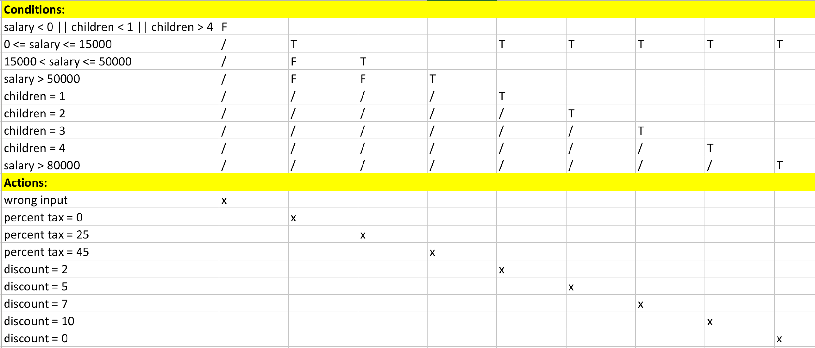
Truth Table Chart

Slide 41
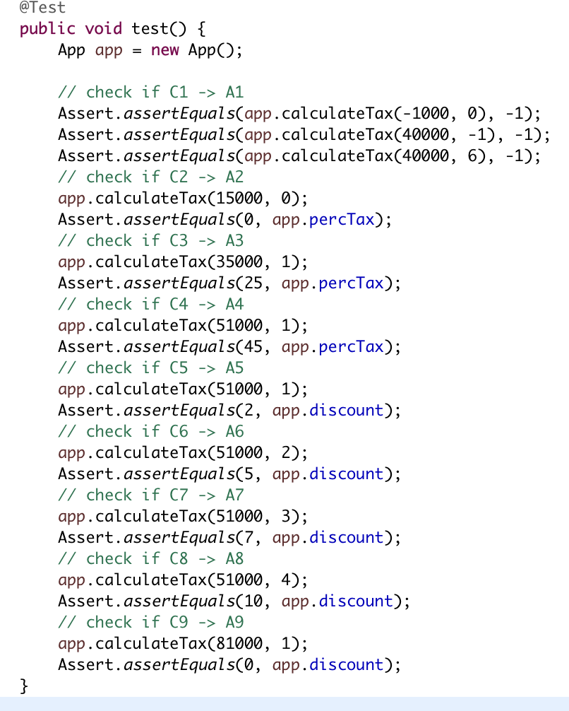
Test Cases

Slide 42
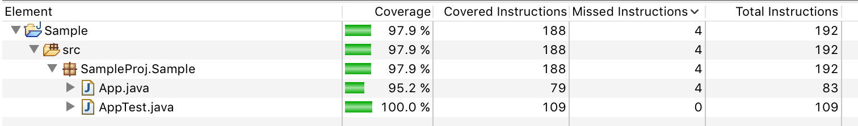
Results

Slide 43
White-Box Testing Criteria

Slide 44
Data Flow Coverage

Slide 45
What is Data Flow Coverage?
CFG paths that are significant for the data flow in the program
Focuses on the assignment of values to variables and their uses
Analyze occurrences of variables
Definition occurrence: A value is bound to a variable
Use Occurrence: A value of a variable is referred
  Predicate Use: Variable is used to decide if a predicate is true (x < y, etc...)
  Computational Use: Compute a value for defining other variables or output value (x = y, etc…)

Slide 46
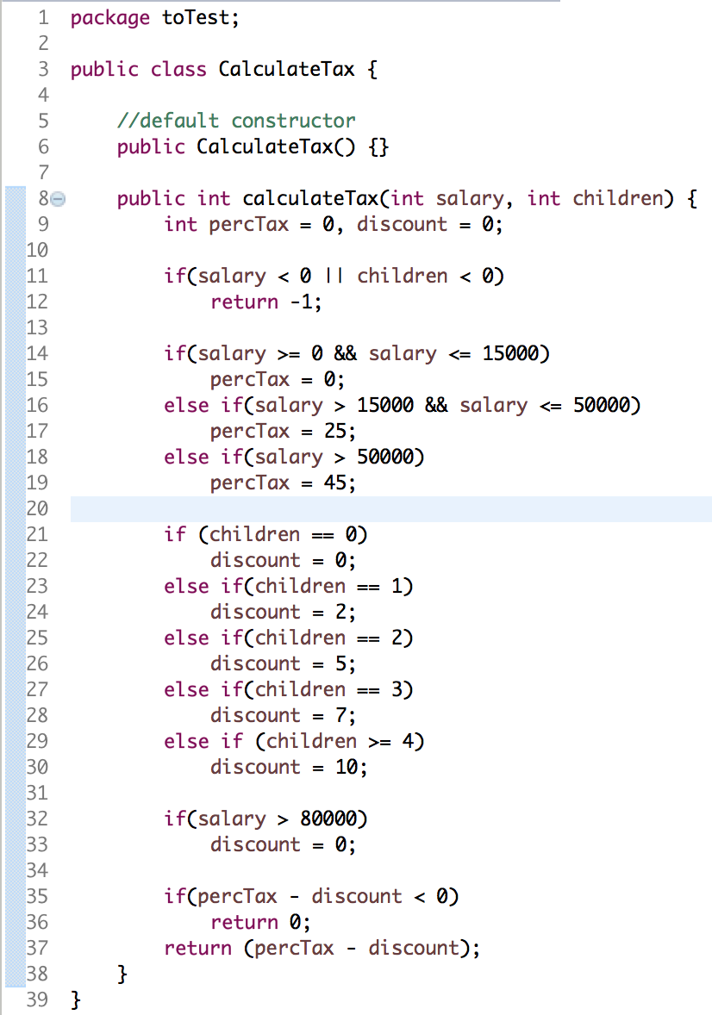
Calculate Tax Example
Variable | Definition LIne | Use Line
percTax | 9, 15, 17, 19 | 35, 37
discount | 9, 22, 24, 26, 28, 30, 33 | 35, 37
salary | 8 | 11, 14, 16, 18, 32
children | 8 | 21, 23, 25, 27, 29

Slide 47
Calculate Tax Example, cont…
P - Uses
C - Uses
Variable | Line
percTax | -------------------------------------
discount | -------------------------------------
salary | 11, 14, 16, 18, 32
children | 11, 21, 23, 25, 27, 29
Variable | Line
percTax | 35, 37
discount | 35, 37
salary | ---------------------------------------
children | ---------------------------------------

Slide 48
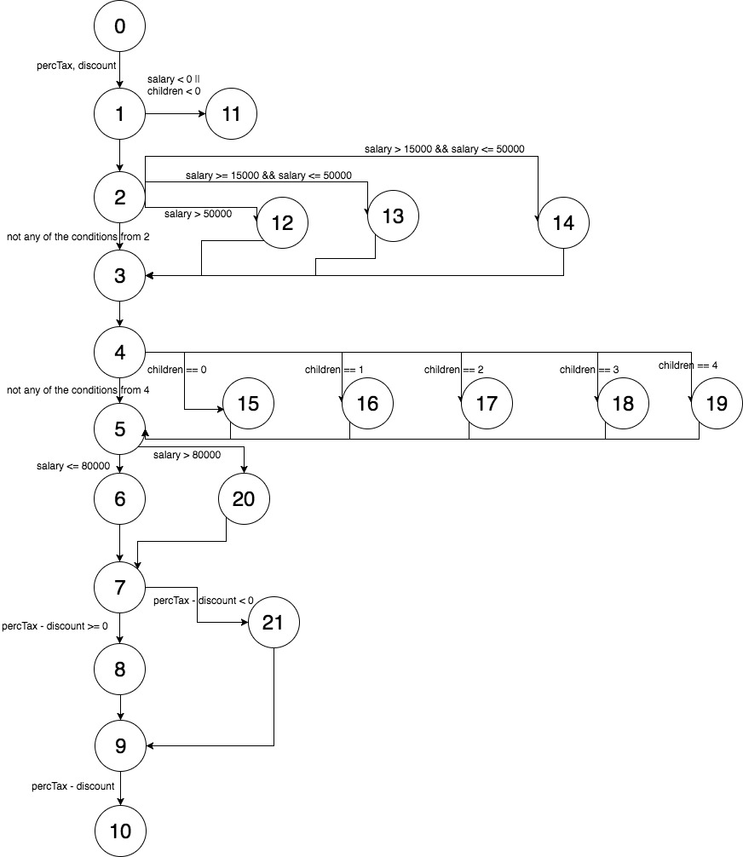
Calculate Tax Control Flow Graph

Slide 49
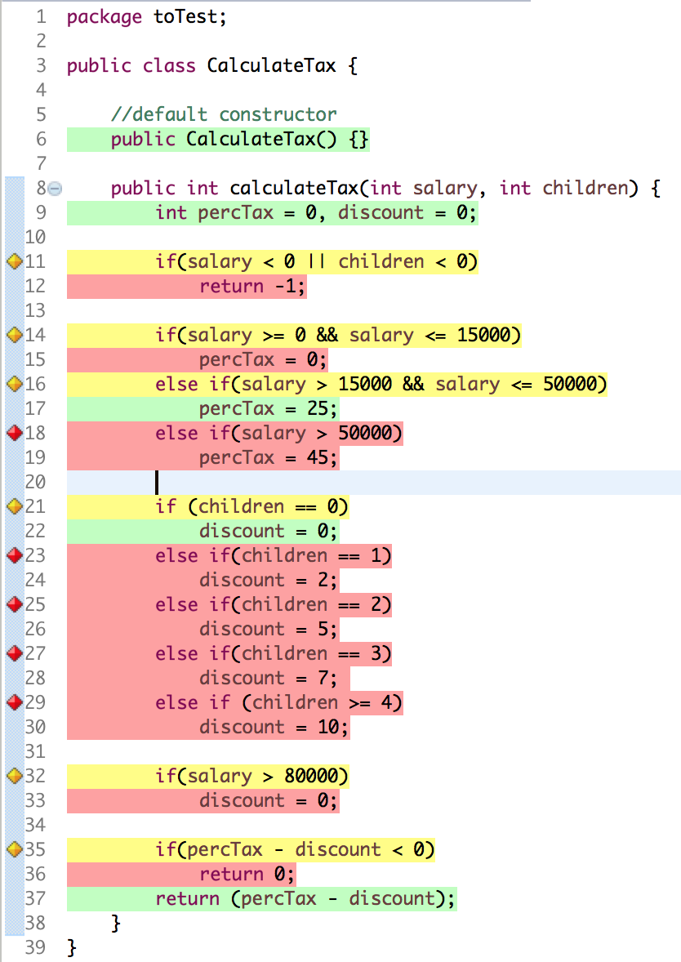
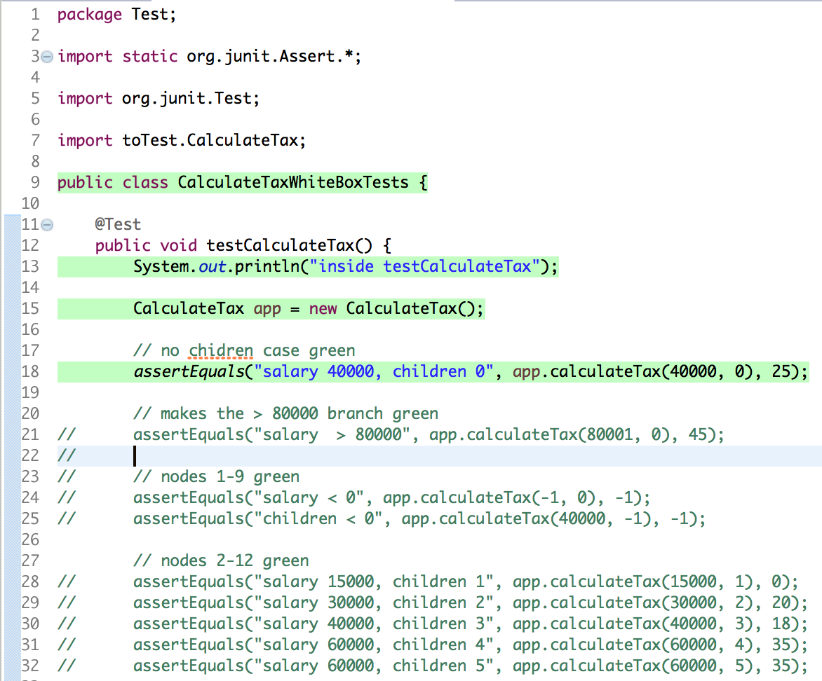
Data Flow Code Coverage in Action

Slide 50
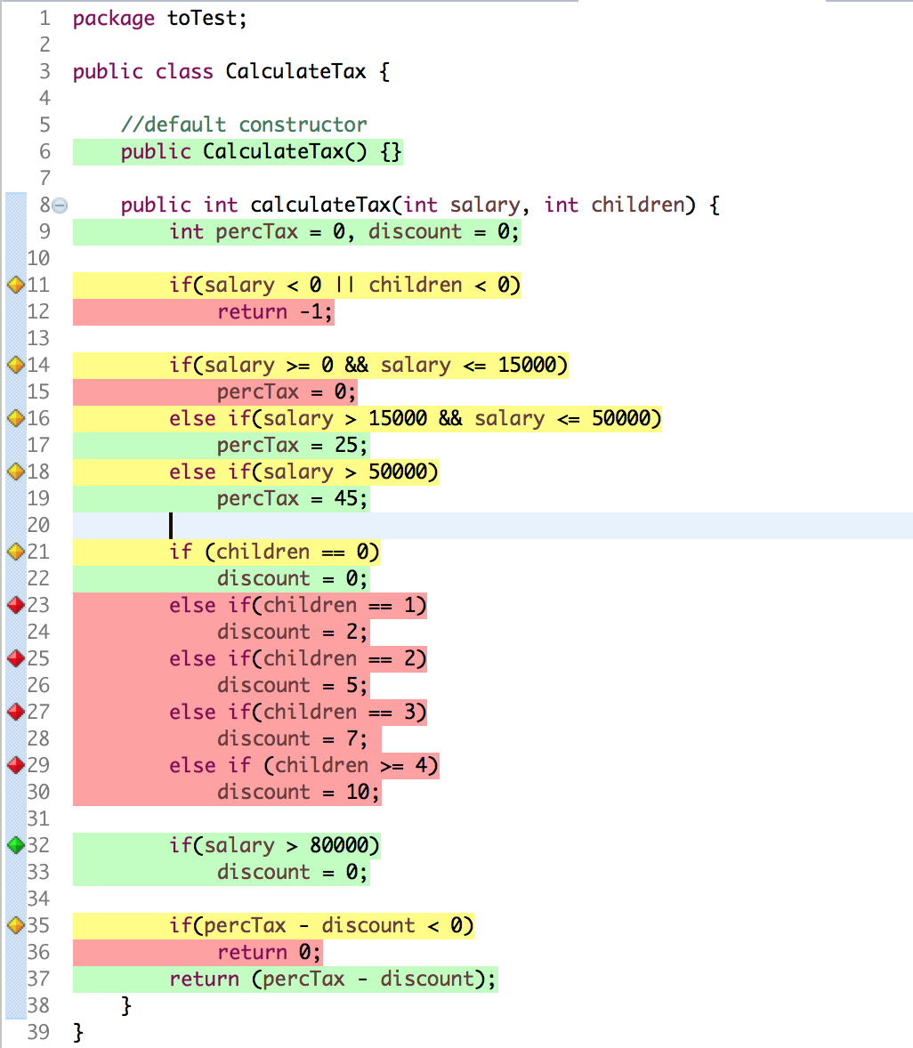
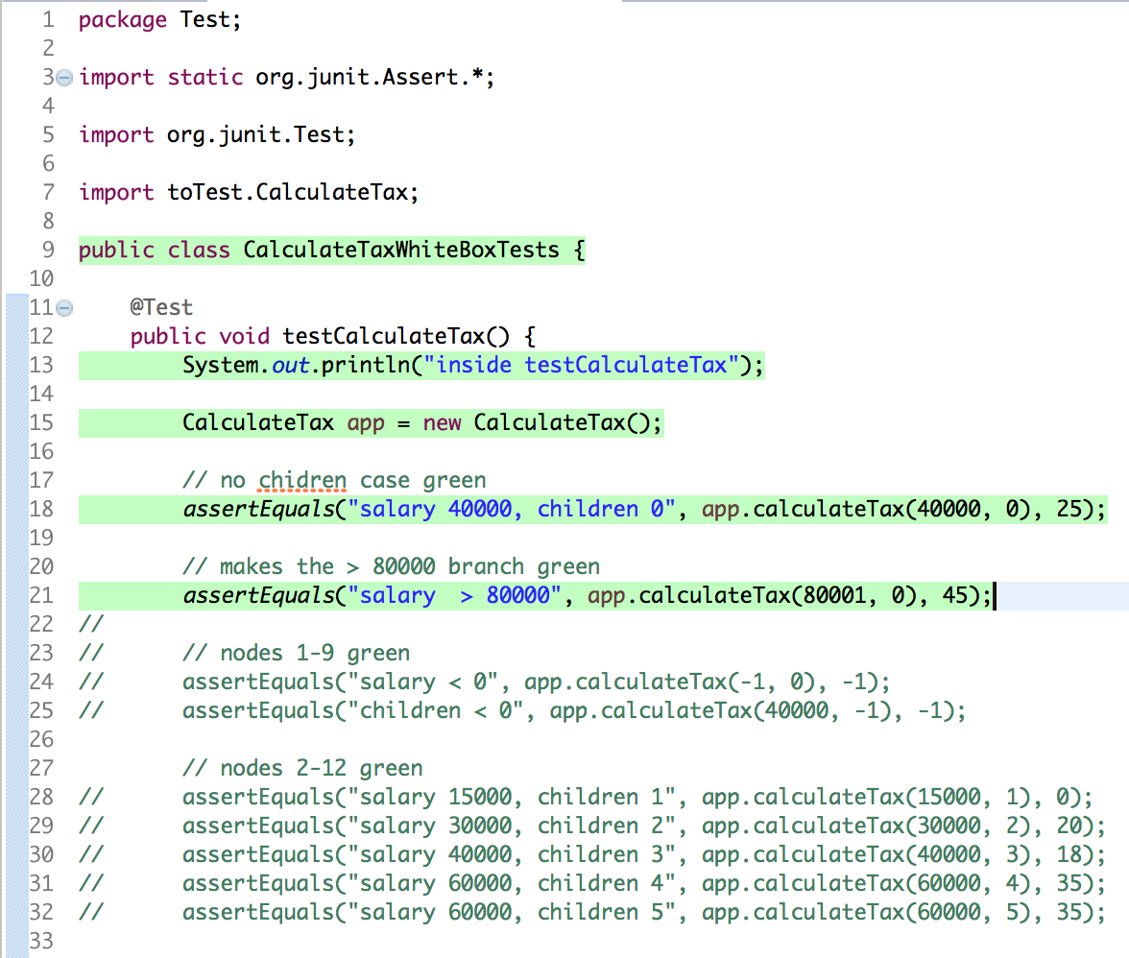
Data Flow Code Coverage in Action

Slide 51
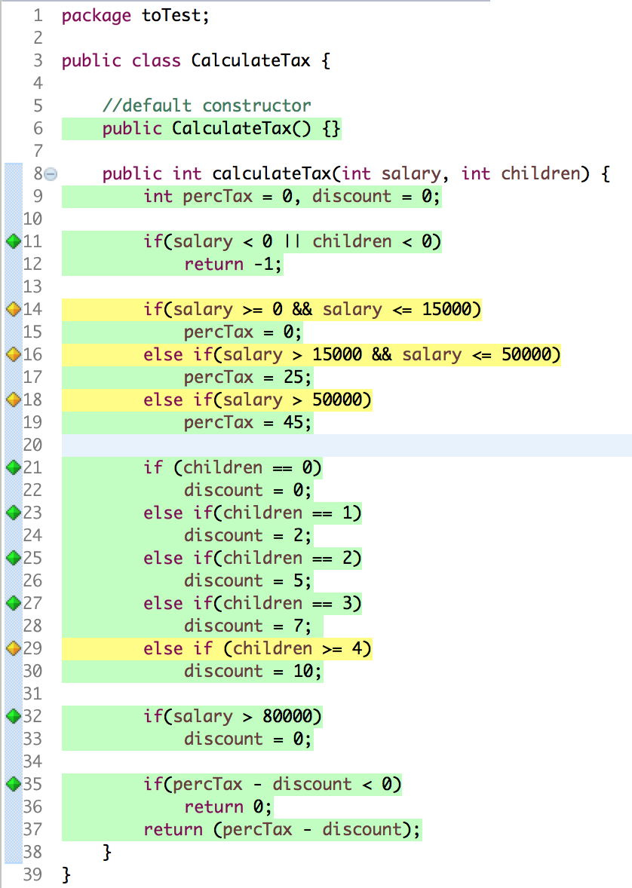
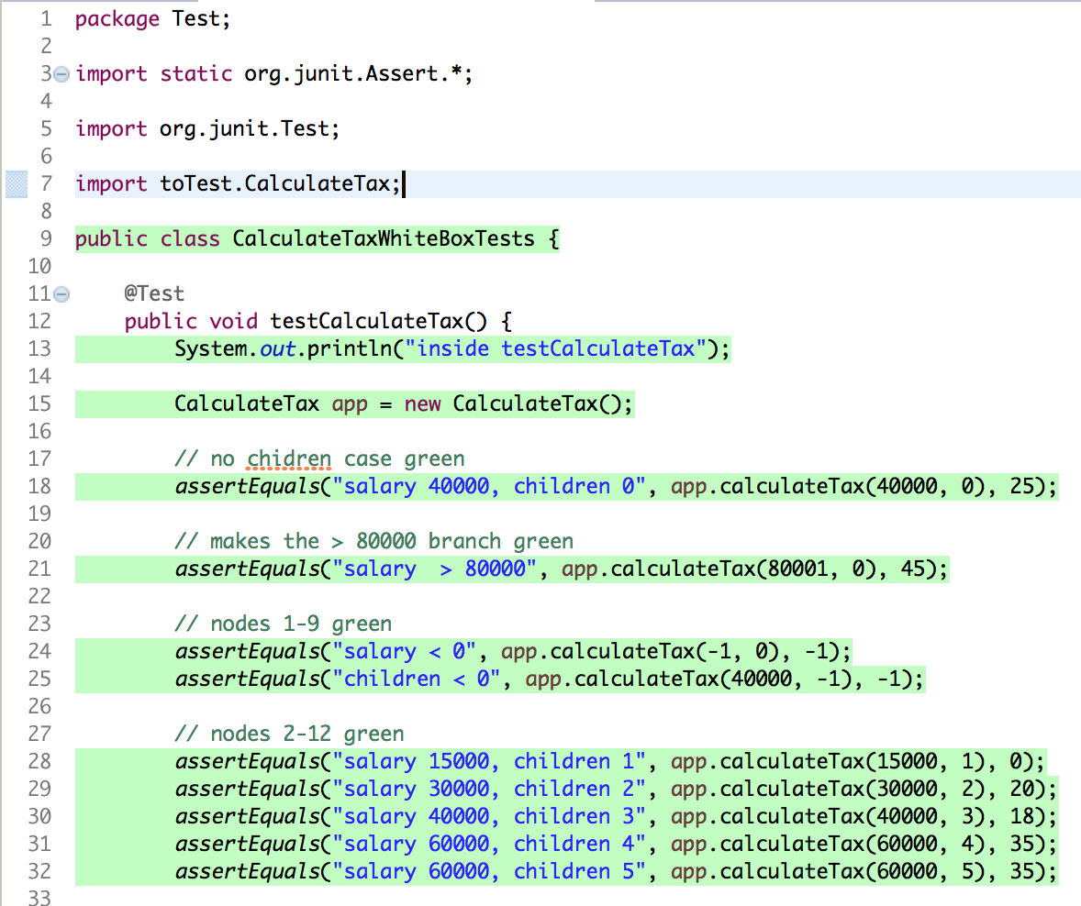
Data Flow Code Coverage in Action

Slide 52
Questions?

